Slide 1
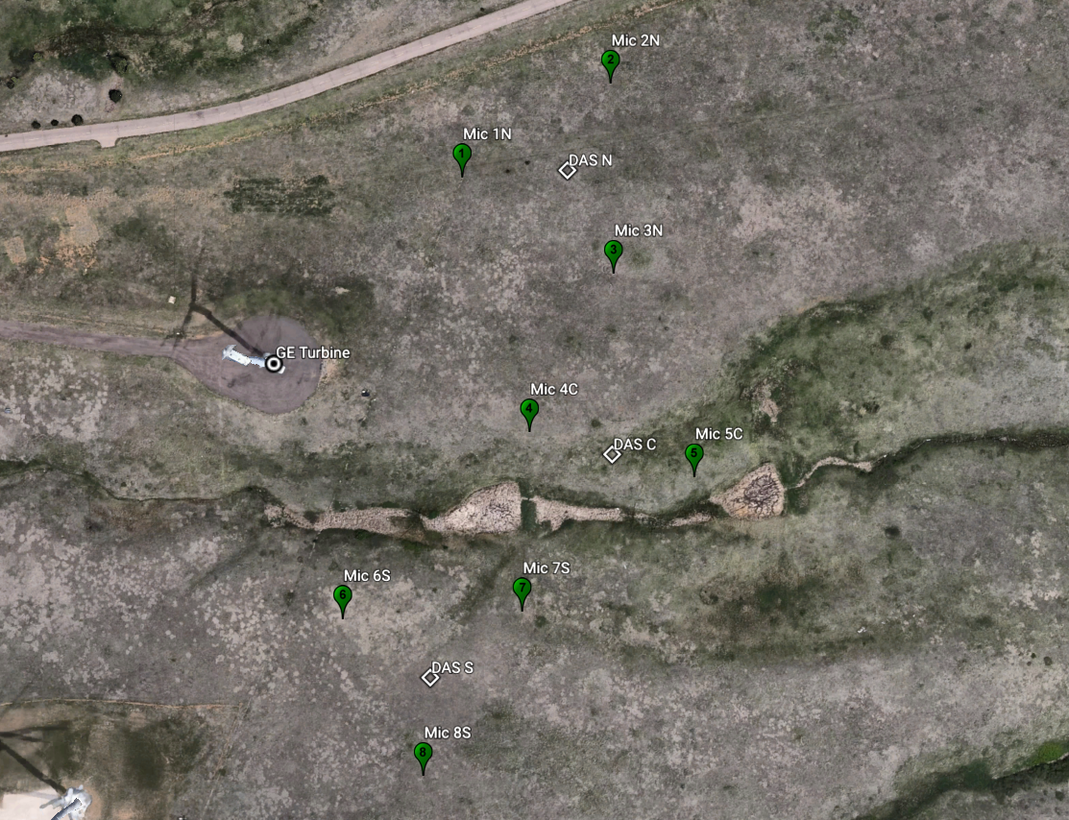
NREL/USFW Border
Equipment locations
Comms, fiber optic
 | Latitude | Longitude
GE | 39.91211 | -105.21996
MIC 1N | 39.9128623 | -105.21902
MIC 2N | 39.9132433 | -105.21824
MIC 3N | 39.9124729 | -105.21822
MIC 4C | 39.9118306 | -105.21866
MIC 5C | 39.9116467 | -105.21778
MIC 6S | 39.9110783 | -105.21965
MIC 7S | 39.9111039 | -105.2187
MIC 8S | 39.9104452 | -105.21922
DAS C | 39.9117386 | -105.21822
DAS N | 39.9128892 | -105.21846
DAS S | 39.9108386 | -105.21918
Power, 14 AWG
Comms, BNC
Soundboard
Data acquisition (DAS)
Audible range measurements are at the MIC XX locations (green markers).
Low-frequency measurements are collocated with DAS subsystems (white markers)

Slide 2
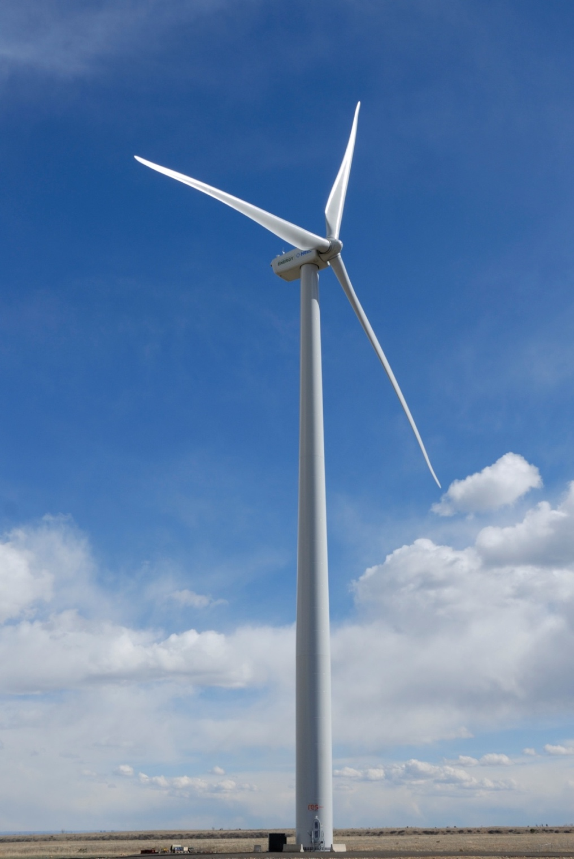
Equipment:
Data acquisition systems (DAS)
3 enclosures holding interface between mics and data server
Sealed for weather,
Cabling in and out
Soundboards
11 locations
Plywood discs of radius 1 m
Supports microphone, wind screen, connects to DAS
Sealed against fouling and water intrusion
Microphones
8 audible-range measurement stations
Mic, preamp
3 low-frequency noise stations
Mic, preamp, signal conditioner
Cabling
Power – approximately 2150 ft 14 AWG connecting each DAS to the GE 1.5 MW wind turbine
Communications – approximately 2150 ft shielded fiberoptic cable connecting each DAS to the GE 1.5 MW wind turbine
Microphone cables – approximately 2000 ft BNC (coax) cable connecting each microphone to the nearest DAS
GE 1.5 MW turbine located at Site 4.0 at Flatirons.
Photo credit: Jeroen van Dam, NREL.

Slide 3
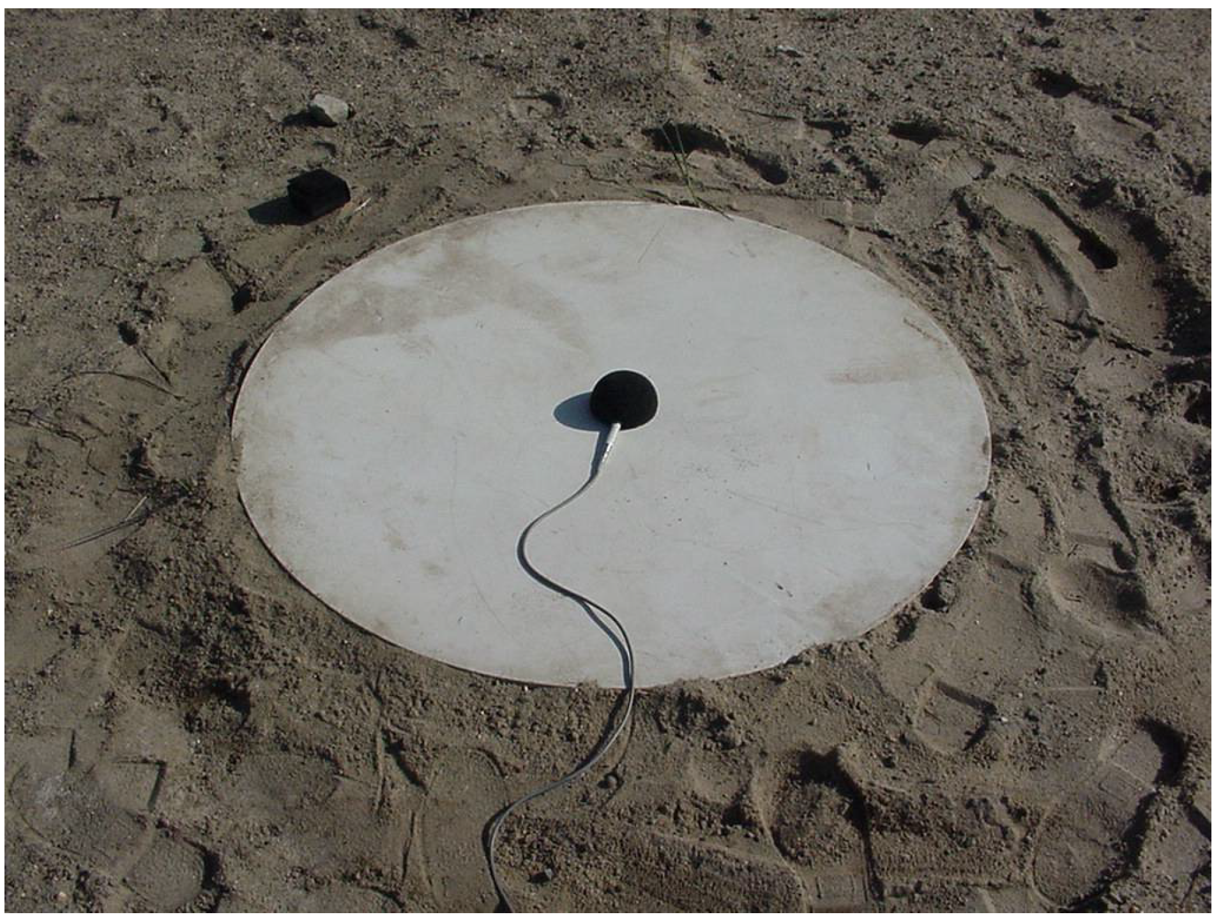
The goal of the Aeroacoustic Assessment project is to characterize the noise emissions of the GE 1.5 SLE MW wind turbine when under modern wind plant control strategies. Testing will include multiple point measurements following recommendations in the International Electrotechnical Commission (IEC) standard, Wind turbines part 11: Acoustic Noise Measurement Techniques, IEC 61400-11.
Measurements will be taken for wind speeds between 6 and 10 m/s and will include periods when the GE 1.5 MW turbine is parked (to establish a baseline for background noise), operating nominally, and yawed to specific values with respect to the incoming wind. A total of 30 minutes of data is required for each wind speed bin, and for each operating condition, leading to a total of 180 minutes of valid data.
A typical testing day will consist of :
Deploying microphones to each sound board
Calibrating microphones with handheld calibrator
Ensuring all equipment is correctly connected and communicating
Measuring acoustic emissions during wind conditions of interest
Moving microphones to safe storage location
Soundboards, DAS enclosures, and cabling will remain in place for the duration of the test, if possible, to ensure consistent measurement locations. All power and fiber optic cables are shielded to prevent damage from weather and wildlife.
Example soundboard from the IEC 61400-11 Standard.
Measurement Type | Requirements
Overall measurements | At least 30 one-minute averages.
For A-weighted sound pressure level: (for turbine and background measurements) | At least 3 minutes of data with wind speeds ±0.5 m/s of the integer values of 6, 7, 8, 9, and 10 m/s
For octave or third octave band measurements: (for turbine and background measurements) | At least 3 minutes of data with wind speeds ±0.5 m/s of the integer values of 6, 7, 8, 9, and 10 m/s
Narrow band measurements: (for turbine and background measurements) | At least 2 minutes of data with wind speeds ±0.5 m/s of the integer values of 6, 7, 8, 9, and 10 m/s
Yaw Offset | 0˚ | 25˚ | 18˚ | 10˚ | -18˚
Duration | 30 min | 30 min | 30 min | 30 min | 30 min

